Slide 1




Slide 2



About us
Eliora Technologies pvt ltd is a passionate and result oriented IT Firm based in the India. From
delivering design to
creative, eye-catching website executing complex algorithms– we
are all ready to jump within your imagination box and resolve your needs. We believe in daily homework to innovate something to benefit the category that ultimately leads to the encouragement of smiles at both sides.

Slide 3



Our Mission
Our Vision statement is to Go along with our happy customers for a rewarding career/growth. We put our best to align every prospect with your business values and goals. We are dealing with adventure every day, and the same leading us to ultimate success.

Slide 4
Core Values
Integrity and Ethics Attentiveness and Thoughtfulness Visualization Honesty Encouragement Responsibility
A principle or belief that a person or organization views as being of central importance.

Slide 5




Our Services
As a full-service agency, our work covers everything from market analysis to brand and identity, advertising and communications, digital, web design and content creation to social media and film. And we offer services across many different geographies and languages.

Slide 6














Our Core Experties
React JS

Slide 7



Staff Augmentation Services
ELIORA offers flexible IT Sta ff Augmentation Services, including C2C( contra ct to contra ct) model, for seamless access to top talent to meet your workforce needs effectively.

Slide 8













Key Features Of Our Contractual Staffing

Slide 9

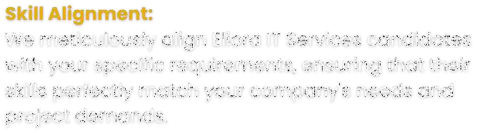
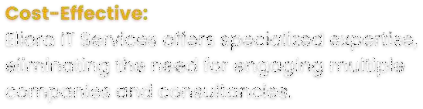

Key Benefits of Our PLACEMENT AND RECRUITMENT Services
With Eliora's placement and recruitment Services, you can build a dedicated team of professionals who are committed to your success. Whether you need ongoing development, project management, or specialized expertise, our placement and recruitment ensures that your organization has the consistent support needed to thrive in a competitive business landscape.

Slide 10



Client description
Eliora IT Company is a reputable organiza tion with a strong presence across India. We are trusted by numerous clients who rely on our exceptional services.
4+ YEARS OF COMBINED EXPERIANCE
30+ PROFESSIONAL EXPERTS
50+ SATISFIED CLIENTS
150+ CUSTOM SOFTWARE & APPS BUILT
10+ INDUSTRIES SERVED
95% CLIENT RETENTION AND REFERRAL

Slide 11

Let's
Connect
vaibhavi@elioratechno.com
www.elioratechnologies.com
+918956001160

Slide 12
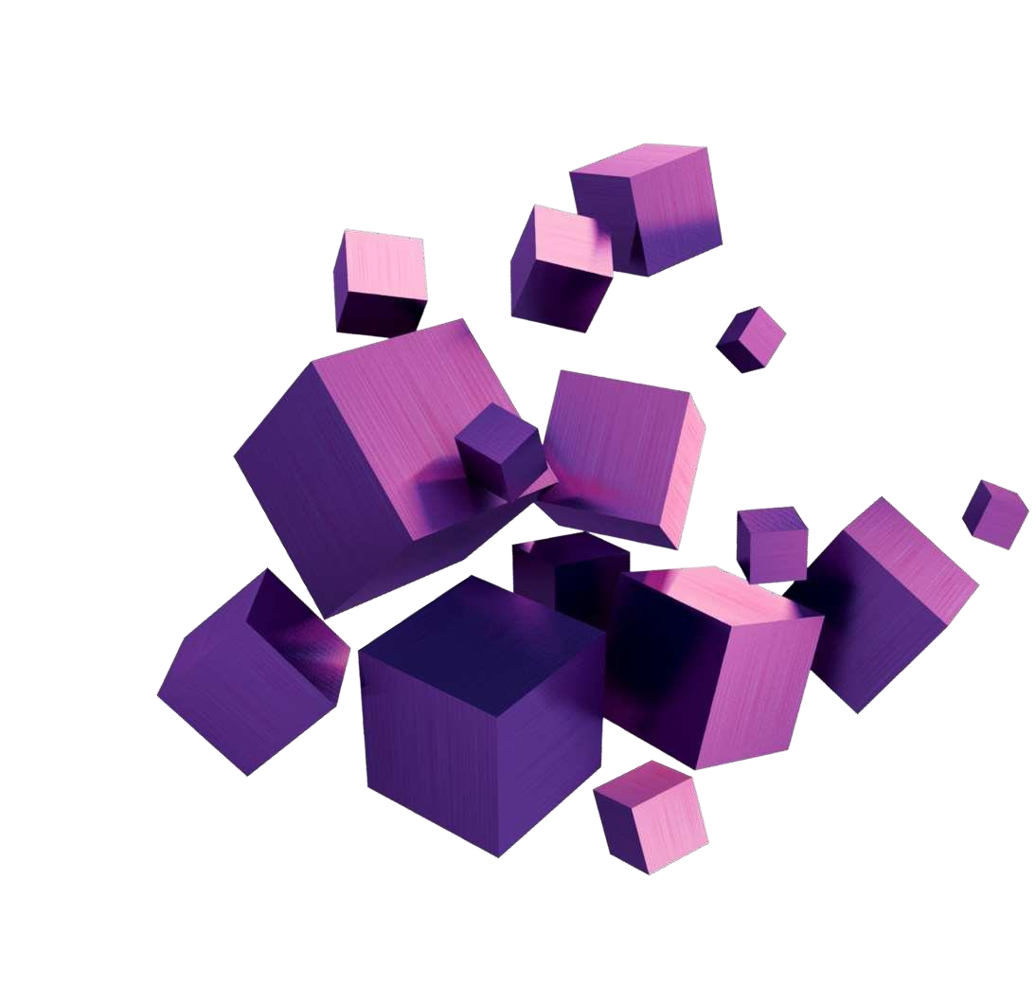

Thank You
Eliora Technologies Pvt Ltd

