Slide 1
CATALOG 2023
LEADING MANUFACTURER Of 4G/5G MDVR In India SINCE 2019

Slide 2
pROFILE
Since 2019, AxelGuard has been committed to providing high-quality but low-cost video surveillance products for commercial vehicles. Today, AxelGuard has become a leading manufacturer in the industry, with a R&D team of more than 60 professional engineers and a factory with a monthly production capacity of more than 50,000 units.
Over the years, we have adhered to the concept of quality first, continuously optimized the product design and the cost through technological innovation and close cooperation with suppliers, and worked with our global distributors and partners to provide our global users with better products and services. We are very proud of this.
We regard our partners as colleagues, fully understand their concerns and protect their interests. This is even more important in today's challenging and uncertain times. We are proactive, sincere, pragmatic and open. We look forward to achieving new success together with our partners and users!
Supply ability: 50,000pcs/month Delivery time: 3-5 days (1000pcs)
Engineers: > 60 Experience: > 15 years

Slide 3
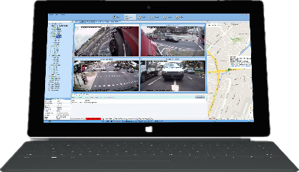
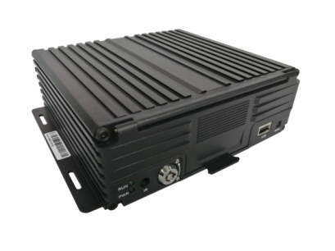
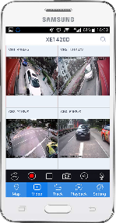
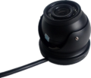
SYSTEM DIAGRAM
CENTRAL SERVER

Slide 4
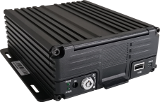
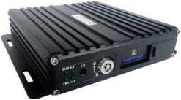
Entry level MDVR
MR9504EC
MR9504
MR9704C
MR9708C
4ch 1080p/720p
1*512G SD
GPS
1*VGA+1*CVBS
8-36V DC
1*TTL
4*Alarm In
4ch 1080p/720p
1*512G SD
4G/GPS/WIFI
1*VGA+1*CVBS
8-36V DC
1*TTL
4*Alarm In
1*Alarm Out
4ch 1080p/720p
1*512G SD + 1*2TB HDD/SSD
4G/GPS/WIFI
1*VGA+1*CVBS
8-36V DC
1*TTL
4*Alarm In
1*Alarm Out
8ch 1080N/720p
1*512G SD + 1*2TB HDD/SSD
4G/GPS/WIFI
1*VGA+1*CVBS
8-36V DC
1*TTL
4*Alarm In
1*Alarm Out

Slide 5
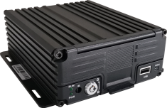
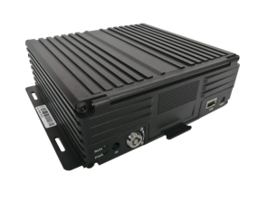
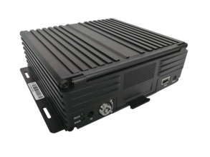
EnHANCEd VERSION MDVR
MR9504E/ED
MR9704E
MR9708E
MR9716E
5ch 1080p (4ch+1ch IPC)
1/2*512G SD
4G/GPS/WIFI
1*VGA+1*CVBS
8-36V DC
1*TTL
1*RS232
1*RS485
1* 1-wire
1*CAN
7*Alarm In
2*Alarm Out
G-sensor
5ch 1080p (4ch+1ch IPC)
1*512G SD+1*2TB HDD/SSD
4G/GPS/WIFI
1*VGA+1*CVBS/AHD
8-36V DC
1*TTL
1*RS232
1*RS485
1* 1-wire
1*CAN
7*Alarm In
2*Alarm Out
G-sensor
10ch 1080p (8ch+2ch IPC)
1*512G SD+1*2TB/4TB HDD/SSD
4G/GPS/WIFI
1*VGA+1*CVBS
8-36V DC
1*TTL
1*RS232
1*RS485
1* 1-wire
1*CAN
7*Alarm In
2*Alarm Out
G-sensor
16ch 1080p (16ch+1ch IPC)
1*512G SD + 1*4TB HDD/SSD
4G/GPS/WIFI (5G & WIFI6 optional)
1*VGA+1*CVBS/AHD
8-36V DC
1*TTL
1*RS232
1*RS485
1*1-wire
2*CAN
9*Alarm In
2*Alarm Out
G-sensor

Slide 6
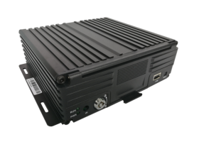
Ai VERSION MDVR
MA9504E/ED
MA9704E
MA9708E
MA9716E
5ch 1080p(4ch+1ch IPC)
1/2*512G SD
4G/GPS/WIFI
1*VGA+1*CVBS
8-36V DC
1*TTL
1*RS232
1*RS485
1* 1-wire
1*CAN
7*Alarm In
2*Alarm Out
G-sensor
ADAS/DSM/BSD
5ch 1080p(4ch+1ch IPC)
1*512G SD+1*2TB HDD/SSD
4G/GPS/WIFI
1*VGA+1*CVBS/AHD
8-36V DC
1*TTL
1*RS232
1*RS485
1* 1-wire
1*CAN
7*Alarm In
2*Alarm Out
G-sensor
ADAS/DSM/BSD
10ch 1080p(8ch+2ch IPC)
1*512G SD+1*2TB/4TB HDD/SSD
4G/GPS/WIFI
1*VGA+1*CVBS
8-36V DC
1*TTL
1*RS232
1*RS485
1* 1-wire
1*CAN
7*Alarm In
2*Alarm Out
G-sensor
ADAS/DSM/BSD
16ch 1080p (16ch+1ch IPC)
1*512G SD + 1*4TB HDD/SSD
4G/GPS/WIFI (5G & WIFI6 optional)
1*VGA+1*CVBS/AHD
8-36V DC
1*TTL
1*RS232
1*RS485
1*1-wire
2*CAN
9*Alarm In
2*Alarm Out
G-sensor
ADAS/DSM/BSD

Slide 7
Pro VERSION MDVR
MR9708P
12ch 1080p (8ch+4ch IPC)
1*512G SD + 1*4TB HDD/SSD
4G/GPS/WIFI (5G & WIFI6 optional)
1*VGA+1*CVBS
8-36V DC
1*TTL
1*RS232
1*RS485
1*1-wire
2*CAN
7*Alarm In
2*Alarm Out
G-sensor

Slide 8
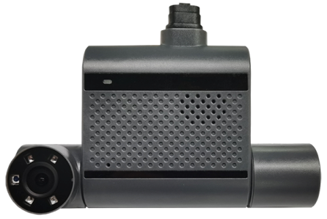
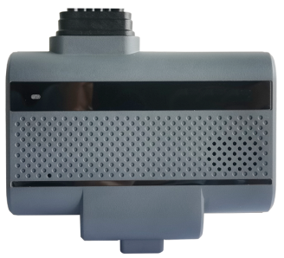
Dashcam
MT95L
MT95C
2ch 1080p
1*512G TF
4G GPS WIFI
Mic & Horns
8-36V DC
1*Alarm In
1*Panic button
G-sensor
4ch 720p
With front camera, with DSM function and DSM camera
2*512G TF
4G GPS WIFI
Mic & Horns
8-36V DC
2*RS232
3*Alarm In
1*Alarm Out
1*Panic button
G-sensor

Slide 9
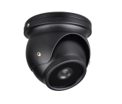
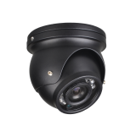
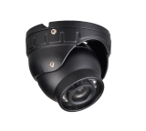
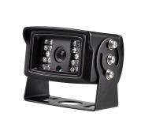
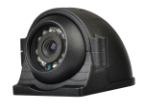
cAMERAS
720p
1080P
Internal camera, without IR, front view, 2.8mm
HDC-A210
HDC-A220
Internal camera, with IR, 2.8mm
HDC-A010
HDC-A020
Internal camera, with IR, with microphone, 2.8mm
HDC-A110
HDC-A120
External camera, with IR, waterproof, 2.8mm
HDC-C110
HDC-C120
External camera, with IR, waterproof, side view, 2.8mm
HDC-A310
HDC-A320

Slide 10
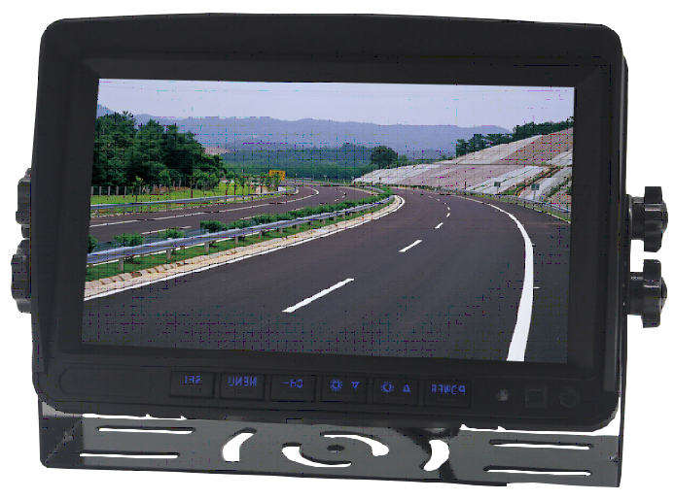
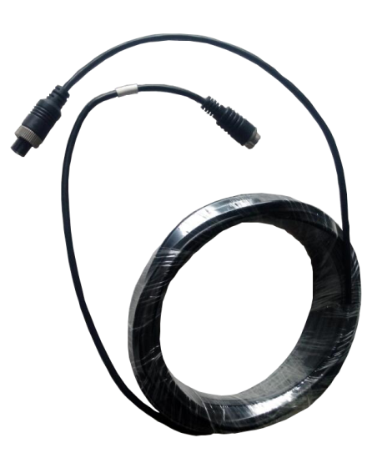
ACCESSORIES

Slide 11
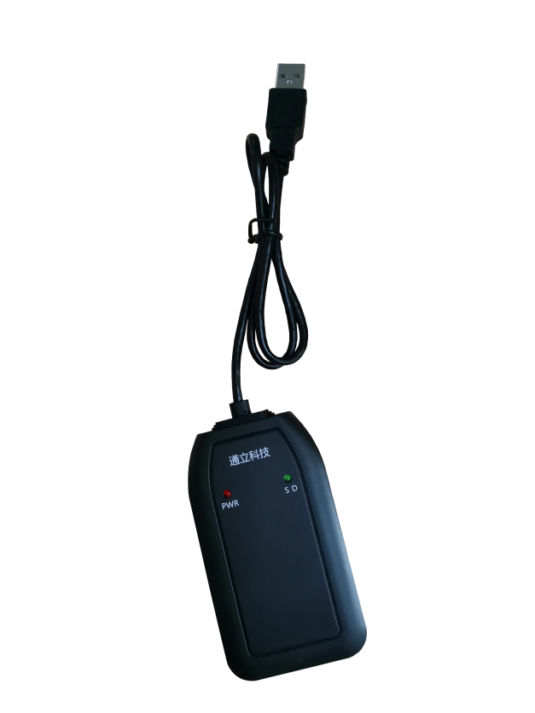
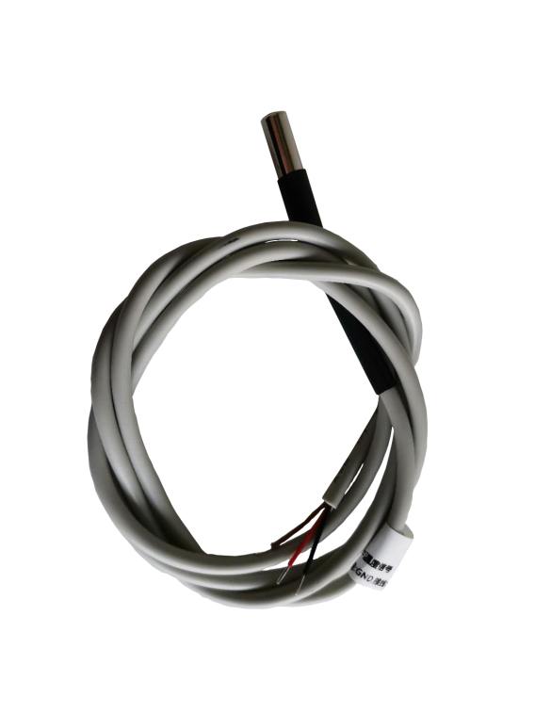
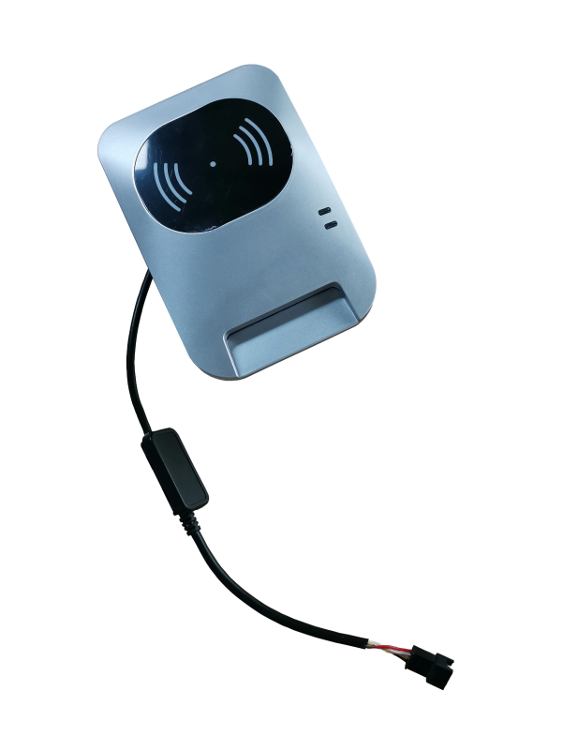
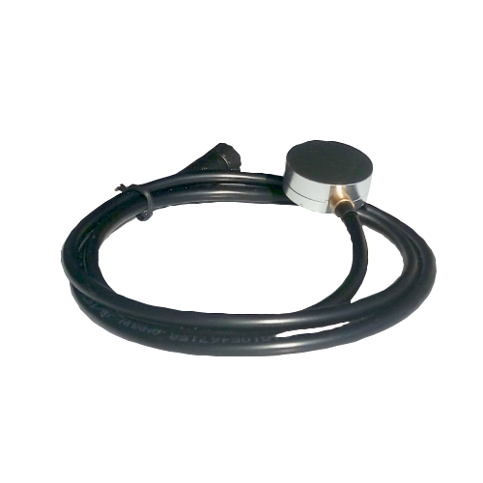
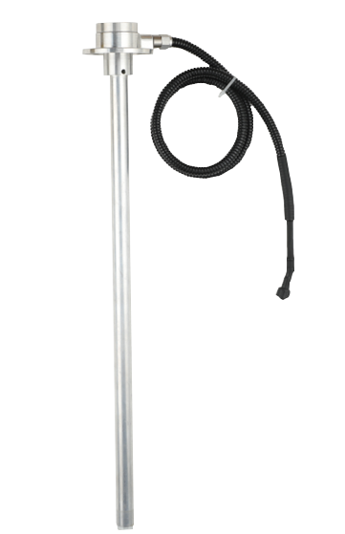
ACCESSORIES

Slide 12
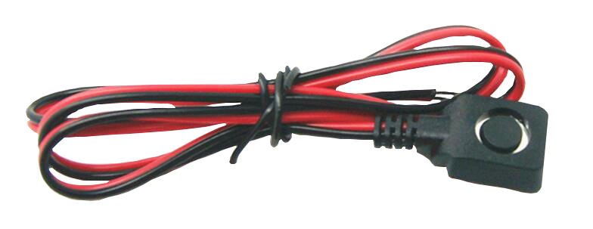
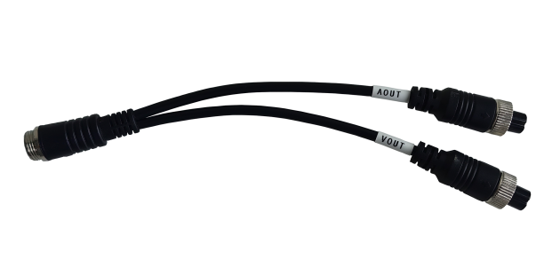
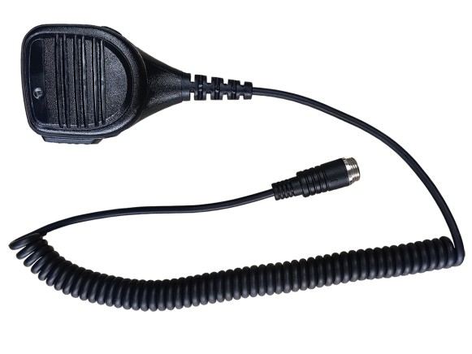
ACCESSORIES

Slide 13
features

Slide 14
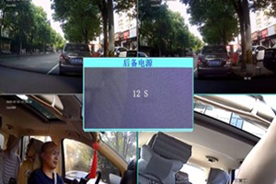
Power outage protection
The DVR has built-in super capacitor. When it lost the regular power supply in accident, the super capacitor will power on the device for several seconds to save the buffer data and shut down the system correctly to avoid data loss and disk damage.

Slide 15
HARDWARE protection
The DVR has multiple protections to avoid hardware damage or accident caused by short-circuit connection, over voltage or reversed plug in

Slide 16
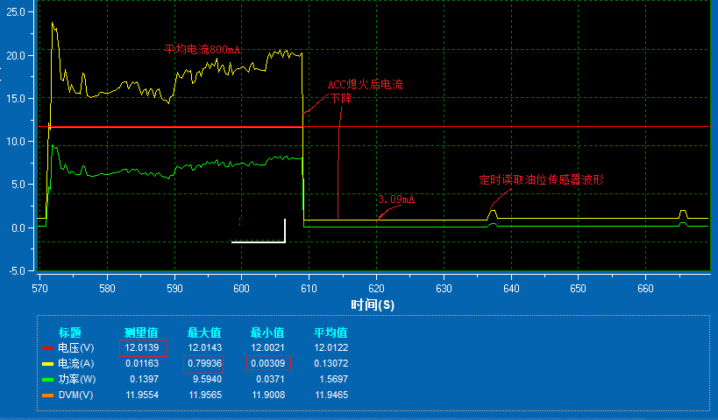
SMART POWER MANAGEMENT
The DVR will detect the power voltage input. If the voltage is lower than the setting, the device will shutdown to protect the vehicle battery and make sure the vehicle engine can be turned on

Slide 17
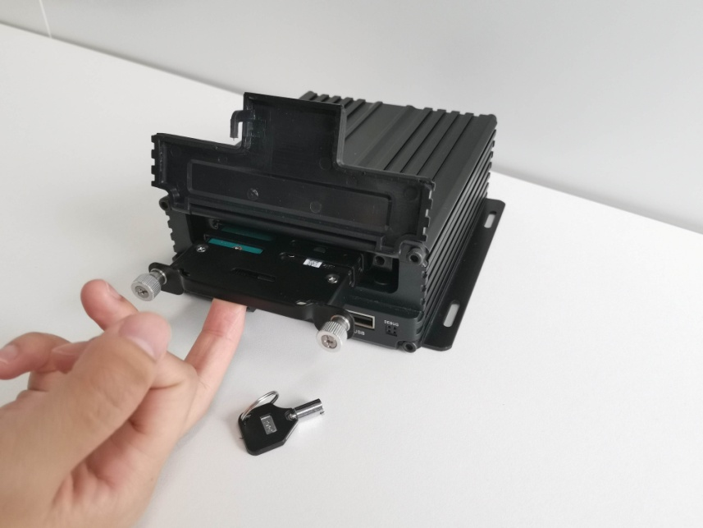
Disk lock
When the lock is open, the device will stop the hard disk first and then the disk can be removed safely so both of the disk and data will be protected.

Slide 18
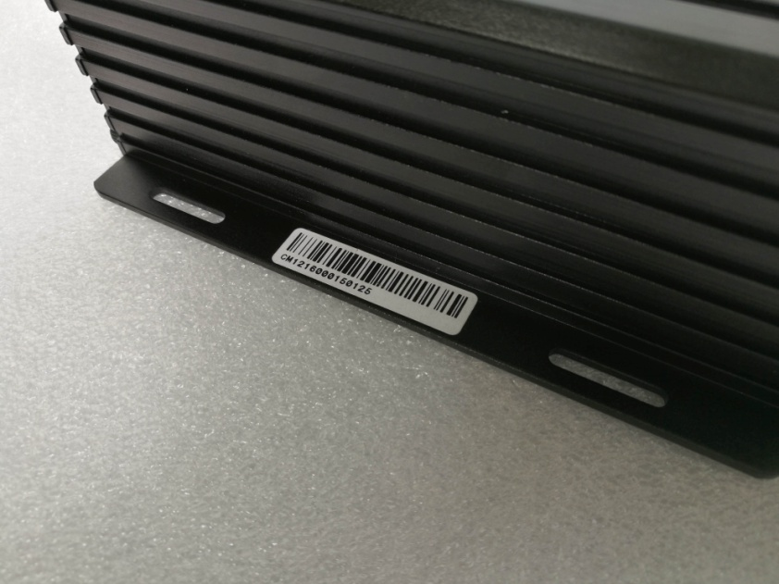
SERIAL NUMBER
Every device has an unique serial number for quality control and after service.

Slide 19
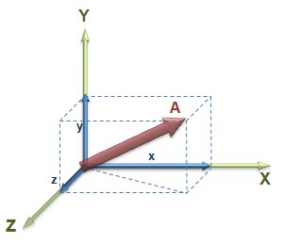
DRIVING BEHAVIORS
The devices have built-in G-sensor to detect unsafe driving behaviors and traffic accidents. These events will be reported to the server platform when detected.

Slide 20
PERIPHERAL CONNECTION
The devices have rich interfaces for peripheral connection in different solutions. TTL, RS232, RS485, 1-wire, CAN

Slide 21
Portable maintenance tool
Insert it into the USB port to set up and config the DVR from phone app without LCD monitor or USB mouse

Slide 22
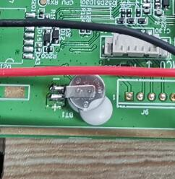
RTC BATTERY
With rechargeable RTC battery, you don’t need to replace the battery after 2-3 years service.

Slide 23
THANK YOU

